Slide 1
Activity Planning
Robert Dunsmore
Notes:
Hi i am Robert Dunsmore and i will be discussing the stage of “Activity planning” within project management.

Slide 2
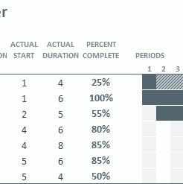
What is an Activity Plan?
Notes:
A brief description of what activity planning is. It is identifying all of the activities involved within a project, the estimated amount of time required for to complete an activity and a schedule of these identified activities.

Slide 3
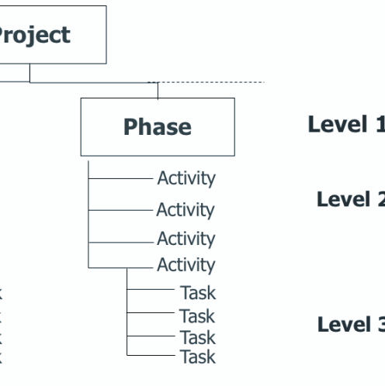
What is an Activity?
Notes:
The first thing that needs to be explained is what an activity is. An activity is a task that needs to be accomplished within a defined period of time (a deadline) to work towards a work-related goal (The compilation of the project). Identifying the tasks of the project is an essential job that serves to differentiate various components of a project.

Slide 4

Why Create an Activity Plan?
Notes:
Now we know what a task is, why would we want to create an activity plan? The main thing that an activity plan provides, is a clear list of all of the tasks that need to be completed to achieve the project deadline. The activity plan also outlines how long each task should take to complete which will produce a time frame for the entire project. Having the tasks outlined means that we can allocate responsibilities and resources to the tasks.

Slide 5

Who Develops the Activity Plan?
Notes:
The activity plan is created by the project manager as they create, execute and control the entire project plan. The project manager may choose to have a designated business expert helping them create the activity plan. Having help to create the activity plan can be useful as the expert may have more experience in developing parts of the project, this inside information can lead to a clearer and more acurite activity plan and timeline that the team will follow, as the expert should have a better estimation how long specific tasks might take.

Slide 6

Identifying Activities
Notes:
The project manager and business expert may use several approaches to identify the different activities that make up the project.

Slide 7
Identifying Activities
Review Project Requirements
Ask The Team
Notes:
One of the approaches that they could use is to relate back to the project requirements, reviewing the project requirements can make it clear what tasks need to be completed to achieve the requirements.The project manager could also ask the project team to look over the task already identified to see if they have they have any input on the tasks already identified or can identify any missing tasks.

Slide 8
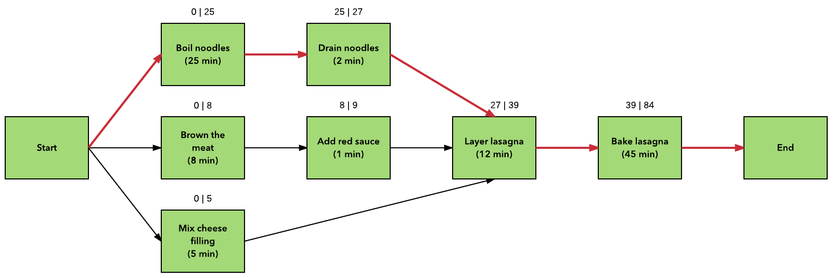
Scheduling Activities
Notes:
Scheduling activities can be done in numerous ways. The main two techniques used when scheduling activities is to create a Project Network diagram and identify the critical path. This diagram can be created be performing a Project evaluation and review technique and a critical path analysis. The critical path is shown in red. These techniques are used in conjunction.

Slide 9
Scheduling Activities
Benefits of Combining Project Evaluation and Review & Critical Path Analysis.
Total amount of tasks in the project
Deration of the inter project
Key sequence of activities in the project
Benefits of Visualising Project Plan
Relationship of Tasks
Parallel Tasks
The Sequence of tasks
Notes:
Combining the two techniques shows the total amount of tasks in the project, deration of the inter project and identify the key sequence of activities in the project plan which must be completed on time for the project to be delivered on its due date. An activity on the critical path cannot be started until its predecessor is complete. Tasks that are delayed on the critical path will affect the delivery time of the project.The techniques us diagrams to visualise the activity plan which gives a module timeframe for the project. Project evaluation uses a diagram named Project Network, while the critical path analysis creates a critical path on the project diagram. Critical path analysis can be performed using different diagrams and charts for example a gantt chart. The diagrams shows the relationship that each task has, what tasks can be do in parallel and shows the order in which tasks are to be completed in.

Slide 10
Scheduling Activities
Identify the specific activities and milestones
Determine the proper sequence of activities
Estimate the time required for each activity
Create a visualisation of the activity plan
Notes:
Both techniques have similar steps, the difference is they way that the diagram is structured. The following steps can be applied to multiple techniques:
Identify the specific activities and milestones
Milestones are the events that mark the beginning and the end of one or more activities.
2. Determine the proper sequence of activities.
This step goes hand & hand with the first step as the activity sequence is clear of some tasks. However other task might require some analysis to determine the exact order in which they should be performed.
3. Estimate the time required for each activity.
Weeks are a commonly used unit of time for activity completion, however any unit of time can be used.
4. Create a visualisation of the activity plan.
With the information gathered in the previous steps, ether a network diagram and critical path can be created or a different technique showing the key tasks need to be completed to deliver the project.

Slide 11
Scheduling Activities
Notes:
When the critical path is identified it can clearly be seen where effort can not be compromised. If any of the activities on the critical path change, the end date of the project will be affected.

Slide 12

Any Questions?
Notes:
That brings me to the need of the talk, i hope that was clear to understand and you have an understanding on what a task is, why activity plans are imported and how they can be organised. Any questions.

